Slide 1
Predictive ability of frailty measures in all-cause mortality in older patients diagnosed with non-small cell lung cancer patients: a large-scale retrospective cohort study
Summary

Slide 2
Frailty screening in elderly cancer patients
Current clinical guidelines and consensus have recommended to apply frailty screening for all older adults aged 70 years and older.
Frail cancer patients are reported to be at increased risk of chemotherapy intolerance, postoperative complications, and mortality
→ It seems to be more necessary to screen frailty for elderly cancer patients. However, which frailty measures are suitable for lung cancer population are still unclear.

Slide 3
1. Background, Method
Objective: Compare ability of frailty measures to predict mortality for patients aged 65+ and diagnosed with non-small cell lung cancer
Study population:
From 1/2007 to 12/2018
Diagnosed with lung cancer (C33, C34)
Age 65+
Received cancer treatment within 4 months after cancer diagnosis
4799 medical records
Patients with small cell lung cancer (n=524)
Missing data for calculating frailty score (n=22)
Final cohort: 4253 patients, followed up until 12/2020
Outcome: all-cause mortality

Slide 4
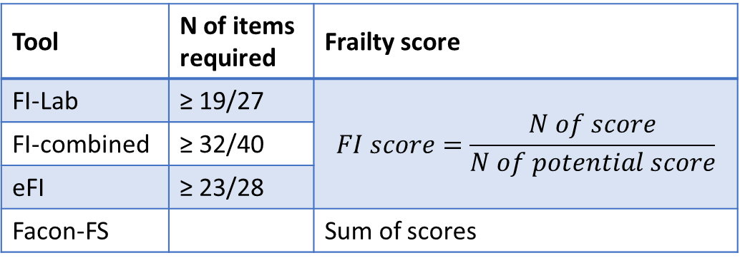
Extract data for frailty information
Type of variables | How to extract
Laboratory tests | Results from last health examination before initial treatment at NCC
Comorbidity | ICD-10 codes, nursing evaluation before initial treatment
Others (BMI, living together) | Nursing record table
When some variables measures the same disease or overlap:
Maximize number of patients detected with this disease → merge into 1 variable
Tool | N of items required | Frailty score
FI-Lab | ≥ 19/27 | $$FI score=\frac{N of score}{N of potential score}$$
FI-combined | ≥ 32/40
eFI | ≥ 23/28
Facon-FS |  | Sum of scores

Slide 5
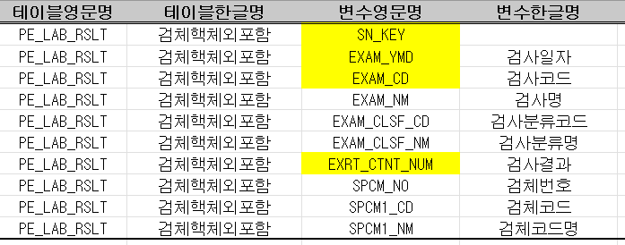
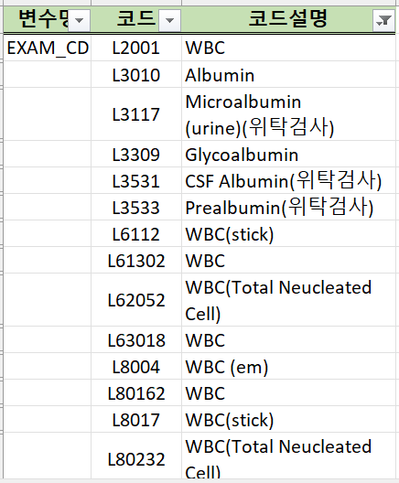
Lab tests
List of lab tests in FI-Lab
Table in CRDW: specimen tests
1. Date of test → before & closest with date of initial treatment
Code tests
2. Check distribution of results of each code tests
→ select the appropriate
Test results

Slide 6
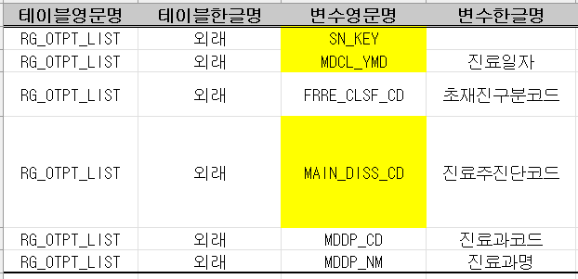
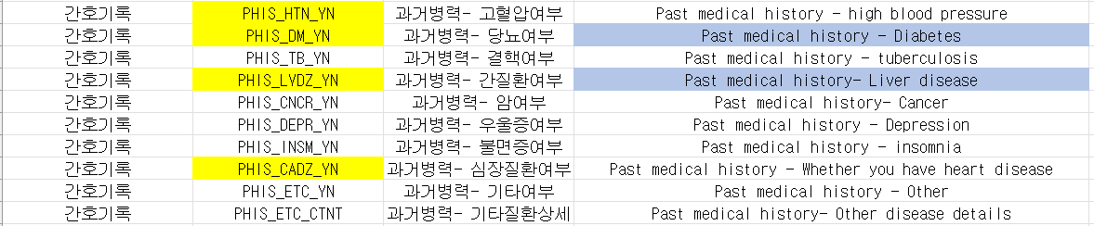
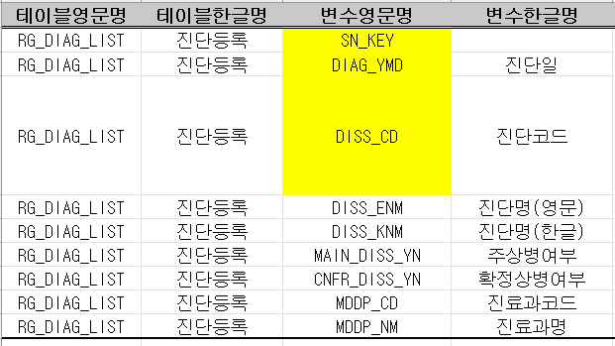
Comorbidities
2. Find ICD-10 code in 2 tables
Outpatients
Diagnostic registration
3. Find info of some comorbidities in table Nursing record
1. Find ICD-10 code of comorbidities

Slide 7
Others
table Nursing record

Slide 8
Statistical methods
Cutoff for FI-Lab, eFI, FI-combined
Logistic regression with FI as the only independent variable
Youden index to choose optimal cutoff
→ FI-Lab: 0.24, FI-combined: 0.17, eFI: 0.04
Compare frailty measures
Kaplan-Meier curves and log-rank test
Cox PH model with covariates being:
For total population, treatment groups: age, sex, SEER stage
For SEER stage groups: age, sex
C-index at 1 year, 3 years, 5 years
Time-dependent AUC up to 5 years followed-up
Without death information
→ can not identify cutoff for frailty index
→ can not estimate the prognosis power of different frailty measures in different time follow-up, although frailty is of importance in older cancer patients

Slide 9
Results
Figure 1: Kaplan-Meier curves of overall survival in total population stratified by A) FI-Lab, B) FI-combined, C) eFI, D) Facon-FS
For Facon-FS, survival curve of unknown frail group is not shown

Slide 10
Figure 2: Kaplan-Meier curves of overall survival in SEER stage groups stratified by 1) FI-Lab, 2) FI-combined, 3) eFI, 4) Facon-FS
For Facon-FS, survival curves of unknown frail group are not shown

Slide 11
Figure S1: Kaplan-Meier curves of overall survival in treatment groups stratified by 1) FI-Lab, 2) FI-combined, 3) eFI, 4) Facon-FS

Slide 12
Frailty is significantly associated with all-cause mortality in NSCLC patients, regardless of FMs

Slide 13
C-indices of survival models with and without frailty measures to predict overall survival at 1 year, 3 years, and 5 years after cancer diagnosis
FI-Lab can be considered for advanced-stage NSCLC older patients

Slide 14
Frailty comprised by comorbidities and functional status are most appropriate for early-stage NSCLC patients

Slide 15
Table 3: Estimated 5-year survival probabilities for man, aged 65 years, diagnosed with NSCLC by cancer stage and frailty status based on different frailty measures
Frailty screening is of importance in cancer
By using appropriate frailty measures for different NSCLC stages, oncologists can inform and discuss with patients about treatment modality, or palliative care

Slide 16
Discussion
Strength
Limitation
Large cohort of a specific cancer type (various stages, treatment modalities, long follow-up period)
→ evaluate the predictive power of four FMs in relation to mortality, revealing the possible mechanisms of different deficits on cancer progression
Retrospective study -> missing data, variables -> underestimate frailty

Slide 17
Conclusion
Frailty is significantly associated with all-cause mortality in NSCLC patients, regardless of tools used to measure
FI-Lab can be considered for advanced-stage NSCLC older patients
Frailty comprised by comorbidities and functional status are most appropriate for early-stage NSCLC patients
→ suggesting the different application of FMs in clinical practice for oncology decision-making.

